Slide 2
Empowering Migrants

Slide 3
MIGRANT STATISTICS
1,000,000 Migrants Using MigApp by end of 2018
250 million international migrants
750 million internal migrants
1 in every 7 is a migrant
30 million migrants assisted by IOM in 2016
USD 600B annual remittances

Slide 4
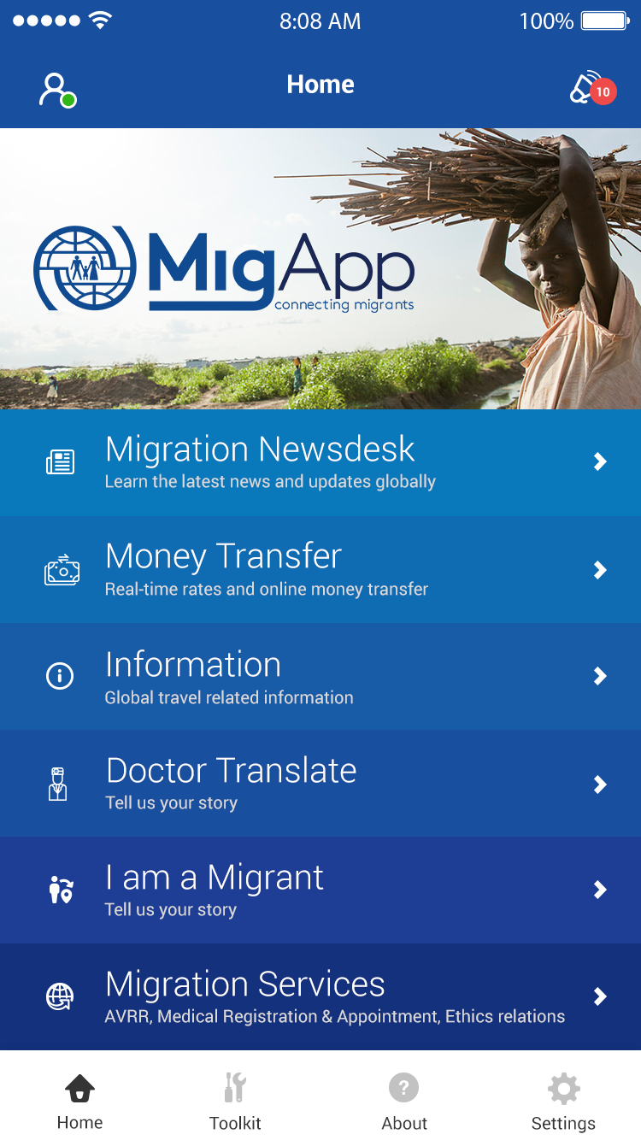
MIGRANT NEEDS
A trusted source of reliable information
Assistance to migrate safely
Low cost money transfer comparison
Information on
risks, visa regulations
health guidelines
migrant rights
Family and friends updated on their location
Access to migration services and programs
A secure space tell their story

Slide 5
VALUE PROPOSITION
Reducing the transfer cost of remittances
Providing information to migrants to help them in making informed decisions
Access to reliable migration information organized by thematic areas and location
Enabling IOM programmes/projects to have a bigger impact and understanding migration profiles and trends
Responding to migrants’ needs for information/services
Governments, international agencies push information to migrants
Other types of information pushed may include: location of local service providers, visa requirements, travel health requirements, relevant processes, warnings of dangers or risks in the area, local mobile apps

Slide 6
PHASE 1 FEATURES
REGISTRATION
MIGRATION INFORMATION
Health Vaccination Requirements
Global Incidents
MONEY TRANSFER
SAFE STORAGE
Visa Information
AVRR - Belgium, Ireland, Turkey, Greece, Netherlands
MIGRANT SERVICES
MY POSITION
Labour Information
Medical Registration
Global CT Hotlines
‘I AM A MIGRANT’
DR. TRANSLATE
IOM Global Health Clinics
Ethics and Conduct
NOTIFICATIONS
IOM NEWS
QUESTION AND ANSWER
INVITE USER

Slide 7
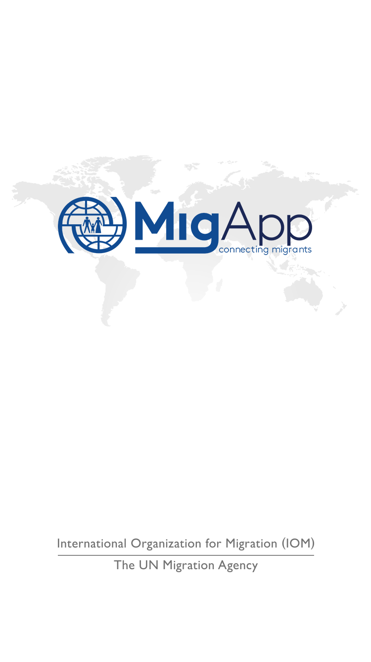
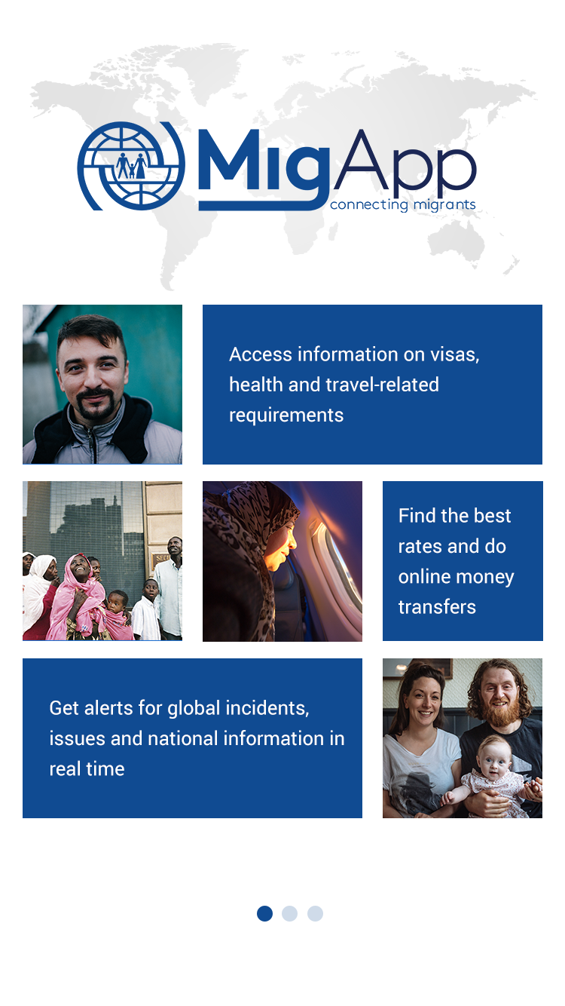
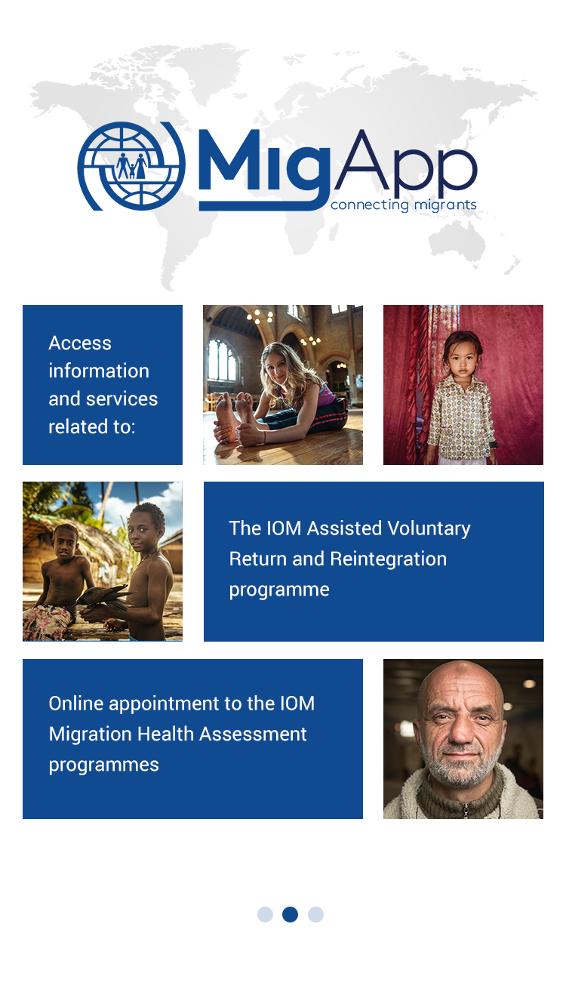
APP DESIGN

Slide 8
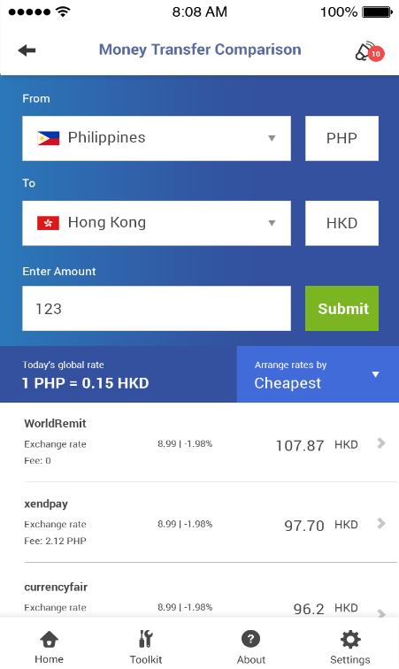
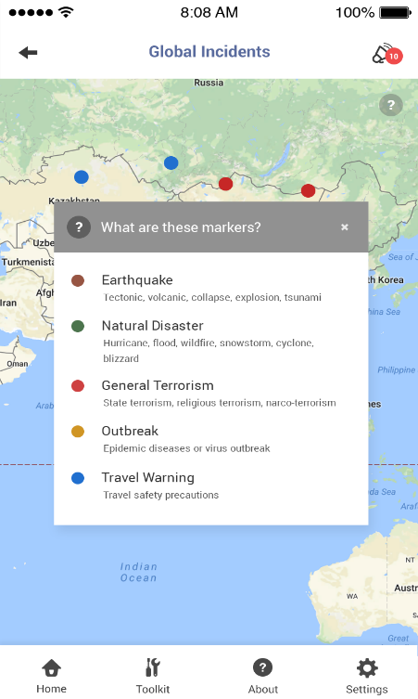
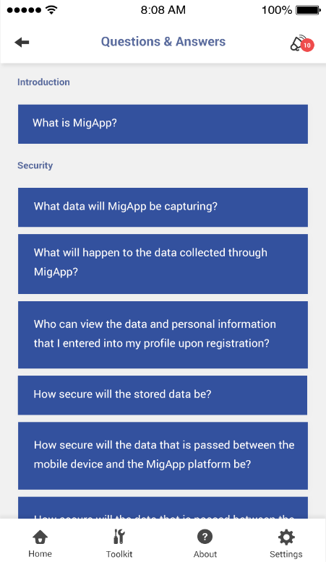
APP DESIGN

Slide 9
UNDERSTANDING MIGRATION PROFILES & TRENDS
Use big data/ technology to track migration flows in order to respond proactively to emerging issues
Anonymized data (data in the migrant’s profile and migration route that do not identify the migrant) collected through the MigApp will be used to analyse global, regional, or local migration patterns.
Data to feed into future migration-related programming and studies that will help IOM to proactively respond to emerging issues.

Slide 10
BENEFITS FOR IOM & PARTNERS
• WIDER SCOPE - Providing more migrants access to programmes
• Stats collected and reported from profiles and migration trends
• Platform for IOM and partners to publish their services, conduct surveys and gather data
• Keeping contact with migrants – two way communication linked to projects
• Reporting to donors how and where their funds have been used

Slide 11
MIGAPP CHALLENGES
• Ownership from the partners, who provide content
• Continuous update of information
• App security, data protection and privacy
• Getting users to download and keep using the app

Slide 12
PROJECT PLAN
SIGN VENDOR CONTRACT
START OF DEVELOPMENT
PUBLIC TENDER PUBLISHED
HOSTING CONTRACT
1ST SYSTEM BLUEPRINT
MONTH 1
MONTH 2
MONTH 3
MONTH 4
MONTH 6
GO LIVE
DEC 2017

Slide 13
available for download
18th December 2017

